Slide 1

Amazon sales
Rohan Argalmani
Internship ID: CRIN2301847
https://public.tableau.com/views/AmazonSalesData_16890756493120/Dashboard1?:language=en-US&publish=yes&:display_count=n&:origin=viz_share_link

Slide 2
Objective:
Sales management has gained importance to meet increasing competition and the need for improved methods of distribution to reduce cost and to increase profits. Sales management today is the most important function in a commercial and business enterprise. Do ETL: Extract-Transform-Load some Amazon dataset and find for me Sales-trend -> month-wise, year-wise, yearly_month-wise

Slide 3
APPROACH FOR DATA ANALYSIS :
Using Various Charts, visualization, data grouping, EDA.
Data exploration
01
Data Cleaning
02
Reading and understaning the complete data
Clearing Null Values or refilling the null values with required one.
Data Featuring
03
04
Graphs & chart
Editing the data set to get desire outcome
helps in detail explanation and understanding of data.

Slide 4
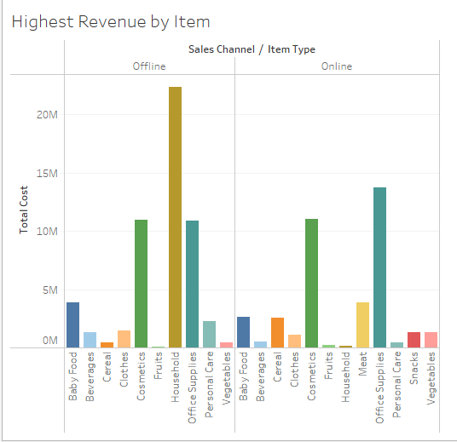
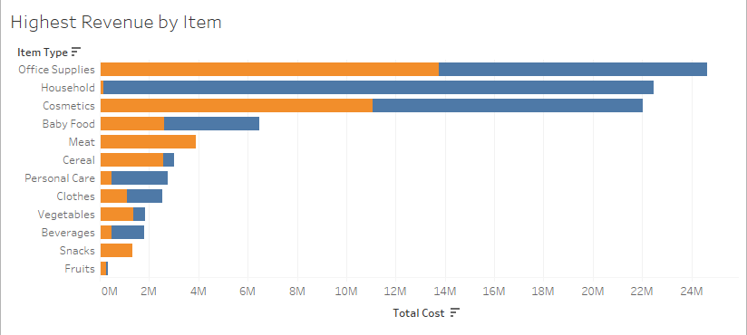
Highest Revenue by item.
Here we see that Revenue Split to offline & online shopping were maximum item shopped is Hosehold in offline , consistenet Item shopped online and offline is Cosmetics, Officesupplies.

Slide 5
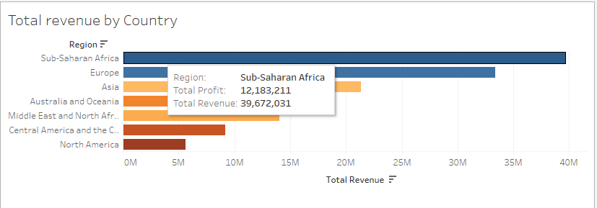
Total Revenue by Country.
The Sub saharan Africe has highest revenue by region with Profit of $12183211 .

Slide 6
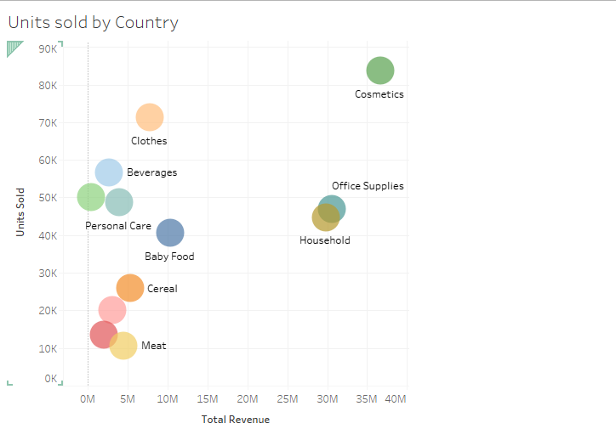
Units sold by Country.
The Average and highly item sold consistantly by countries is Cosmetics.

Slide 7
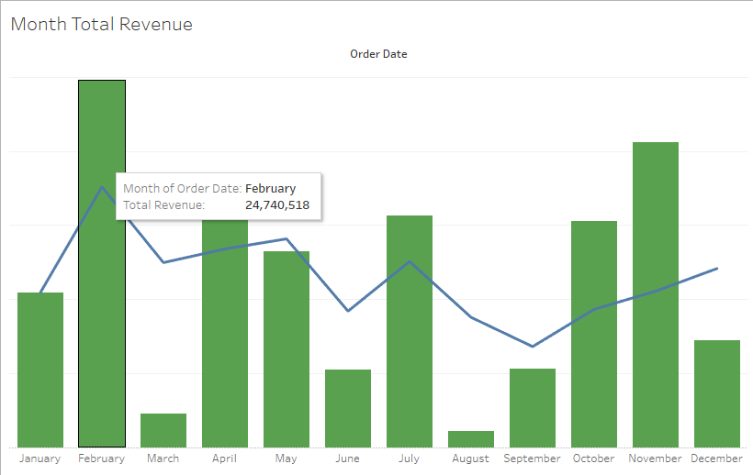
Monthly Total Revenue.
Total revenue by monthly based is highest at the February month.

Slide 8
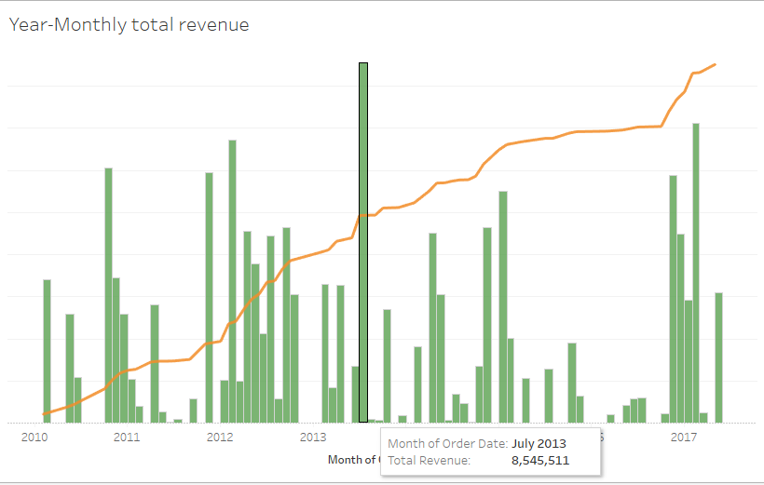
Year-Monthly total revenue.
Based on year-monthly based total revenue july 2013 has highest total revenue. with running total displayed.

Slide 9
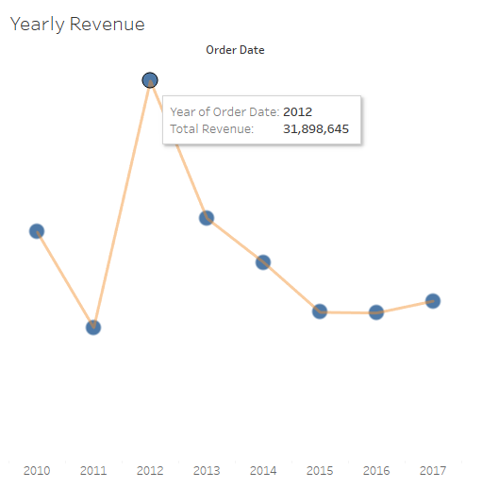
Yearly Revenue.
The maximum profit and revenue earned in the year 2012 ..

Slide 10
Conclusion.
As per the visualization showed above we can conclude that item type having daily useage and regular needed are mostly to be soldout fastly ,
The planing is availability of items offline and online in affordable price
Shiping Dates to made quickly available for customer with good service
Providing Good discounts on Non profitable months to attract customers, also to provide good service, gift vouchers.
To Provide return & reshipment facility to customers.

Slide 11
THANKS
Tableau LINK : https://public.tableau.com/views/AmazonSalesData_16890756493120/Dashboard1?:language=en-US&publish=yes&:display_count=n&:origin=viz_share_link
Python_Notebook: http://localhost:8889/notebooks/Downloads/Amazon%20Data%20Analytics.ipynb

